Slide 1
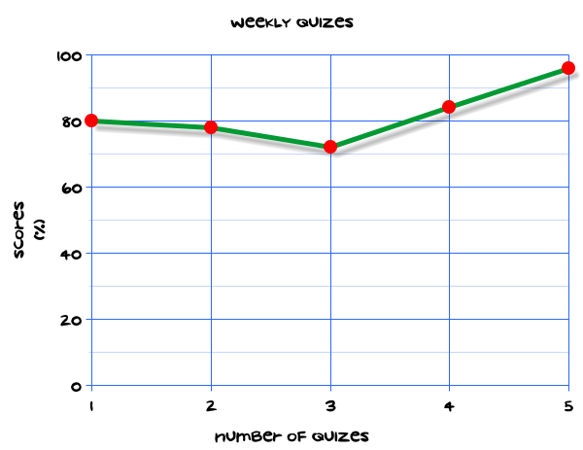
My Statistics Interactive Notebook
Name
Class
Teacher
Term 1 Semester 1
1

Slide 2
Create your own front page
It needs to contain the following –
My number interactive notebook
Name
Class
Teachers Name
Semester 1 Term 1
Page number 1

Slide 3
Contents
Glossary or Formula Page
Page
Date
Description
2
3

Slide 4
Tasks
24
7
30
Essential Question
Questions
Notes
Summary
4
5

Slide 5
24
7
30
Date
Title
EQ –
5

Slide 6
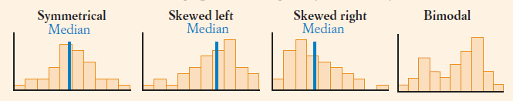
24
7
30
Date
Describing data
EQ –
What terms do we use to describe the distribution of Data?
A symmetrical distribution is roughly the same shape on either side of the middle.
5

Slide 7
24
7
30
Date
Describing data
EQ –
What terms do we use to describe the distribution of Data?
A symmetrical distribution is roughly the same shape on either side of the middle.
A distribution is skewed to the left (negatively skewed) if the scores are spread out more below the median than above the median.
5

Slide 8
24
7
30
Date
Describing data
EQ –
What terms do we use to describe the distribution of Data?
A symmetrical distribution is roughly the same shape on either side of the middle.
A distribution is skewed to the left (negatively skewed) if the scores are spread out more below the median than above the median.
If the scores are spread out more on the right, it is skewed to the right (positively skewed).
5

Slide 9
24
7
30
Date
Describing data
EQ –
What terms do we use to describe the distribution of Data?
A symmetrical distribution is roughly the same shape on either side of the middle.
A distribution is skewed to the left (negatively skewed) if the scores are spread out more below the median than above the median.
If the scores are spread out more on the right, it is skewed to the right (positively skewed).
Bimodal distributions have two high parts, although they don’t always have two actual modes.
5

Slide 10
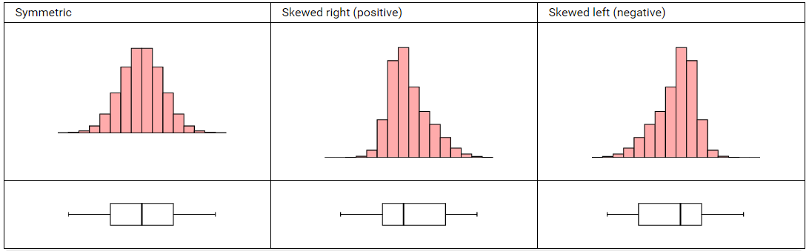
24
7
30
Date
Describing data
EQ –
What terms do we use to describe the distribution of Data?
5

Slide 11
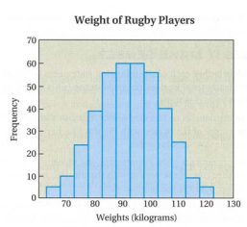
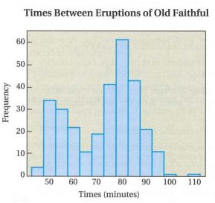
Task
The histogram below describes the data gathered about the weights of a sample of 391 rugby players. Draw a smooth curve that captures its important features. Then classify the distribution according to its number of peaks, symmetry or skewness, and variation.
The histogram below describes the data gathered about the times between 300 eruptions of Old Faithful geyser in Yellowstone National Park. Draw a smooth curve that captures its important features. Then classify the distribution according to its number of peaks, symmetry or skewness, and variation.

Slide 12
Task
Two greyhounds have the following race times (in seconds) over the same meetings.
Houndog: 53, 59, 61, 51, 59, 53, 58, 44, 47, 48, 73, 73, 70, 66, 60, 60, 50, 71, 37, 64
Chaser: 64, 53, 60, 61, 66, 69, 82, 68, 64, 68, 76, 59, 57, 58, 71, 83, 68, 77, 64, 76
a Make a back-to-back stemplot and histogram for the data.
b Compare the greyhounds.
c Compare the greyhounds using the means, medians and ranges and comment on your results i.e. Is the data skewed? If so, how etc.

Slide 13
Questions

Slide 14
Notes Review
24, 7 ,30
Date
Title
Essential question
Notes complete
Notes complete with colour and diagrams
Questions completed
Contents page filed in
Formula page filled in

Slide 15
Homework
Review your notes and write a summary answering the essential question.

